Slide 1
Data Engineering Course
Creating Data Pipe line to convert file from csv to Json using NIFI

Slide 2
Contents
NiFi Docker image installation.
GUI Directories mapping.
Data Pipeline executions.
Processors detailed configurations

Slide 3
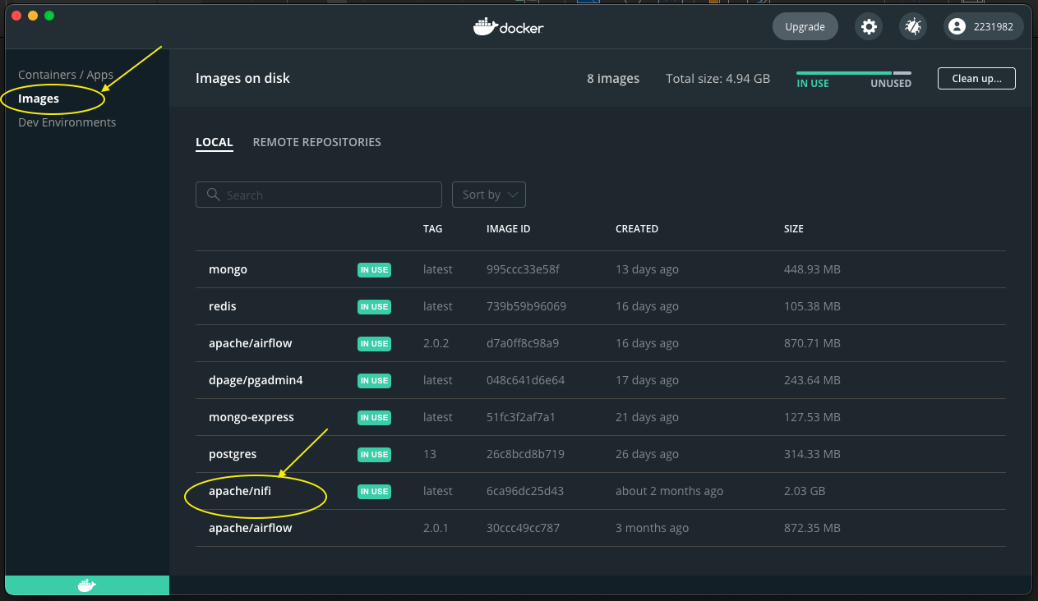
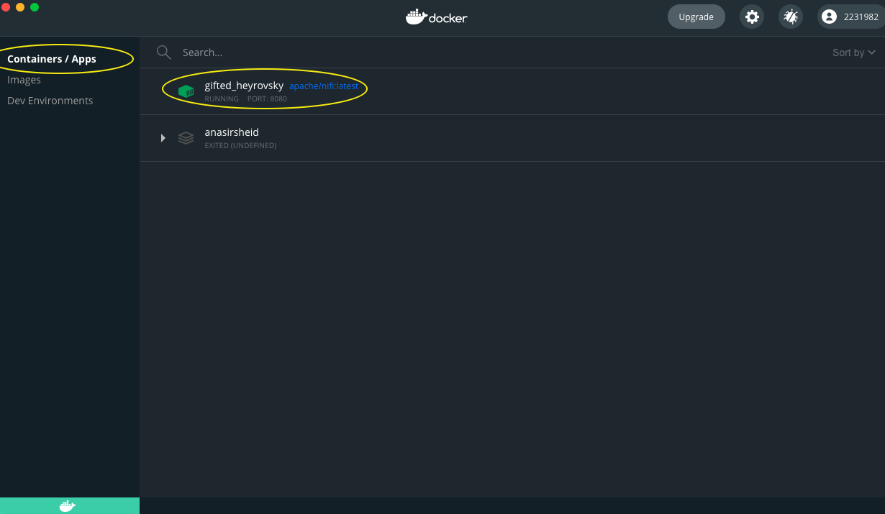
NiFi Docker image installation.
on terminal run the following commands:
docker pull apache/nifi ➔ this command will pull the nifi image from docker hub.
docker build -t apache/nifi:latest ➔ this command will build the Docker image.
docker run --name nifi -p 8080:8080 -d -v /Path/on/your/PC:/opt/nifi/nifi-current/logs apache/nifi:latest ➔ to run NiFi instance and map it to your local directory.
4. On the /Path/on/your/PC please load the data.csv & flow.xml.gz
By implementing the above command on a docker installed machine you will be able to see the status of the image an container OR you can run it and configure it from the run button below as described in next slide:

Slide 4
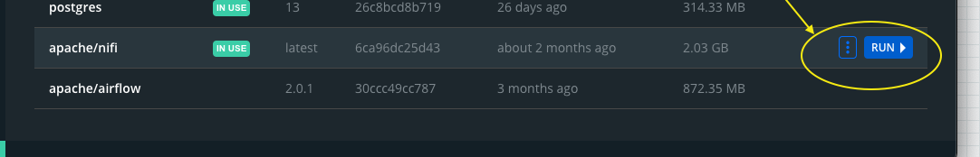
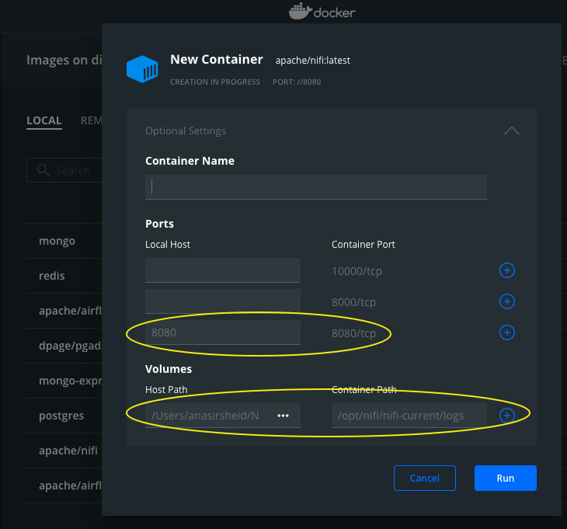
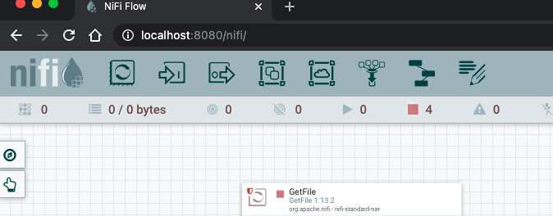
Directories mapping using Docker GUI
To setup a nifi docker image using Docker GUI after completing the first two steps from previous slide with port and local directories we need to implement the following settings:
On the nifi image press run:
This window will popup then set the port to 8080
And to map the default path of nifi to local disk in host path select the path where the data.csv file is exist and in container path select nifi default path /opt/nifi/nifi-current/logs.
3. On your browser type: localhost:8080/nifi ➔ here you go nifi is up and running.

Slide 5
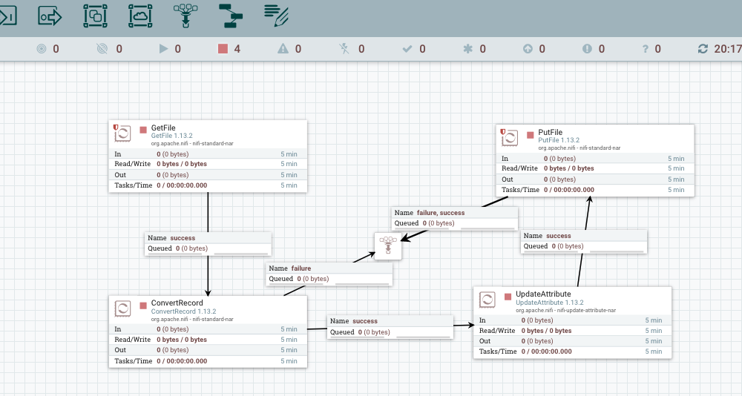
Data Pipeline execution
The below created pipe line is used to convert a data.csv file to data.json file and to perform this operation we will select the below processors mentioned in the graph:
To view the below config access the cli on Docker container and perform the below steps:
1. cd logs : this container directory is mapped to /Path/on/your/PC where you have put data.csv & flow.xml.gz
2. cp flow.xml.gz /opt/nifi/nifi-current/conf ➔ then you must restart the container.
3. On web browser type: localhost:8080/nifi.
1. Getfile processor: to get a file from the directory mapped in the setup in our pipeline we select csv files.
2. ConvertRecord processors: to read a csv file and convert the content into json records.
3. Updateattribute pocessesor: to update the file name to filename.json.
4. Putfile processor: to load the converted file into the directory that we have setup.
5. Click on any free space on nifi page and click Start. Refresh the page you will see the pipeline has completed the work and the new file.json will be found on the mapped directory

Slide 6
Processors detailed configurations

Slide 7
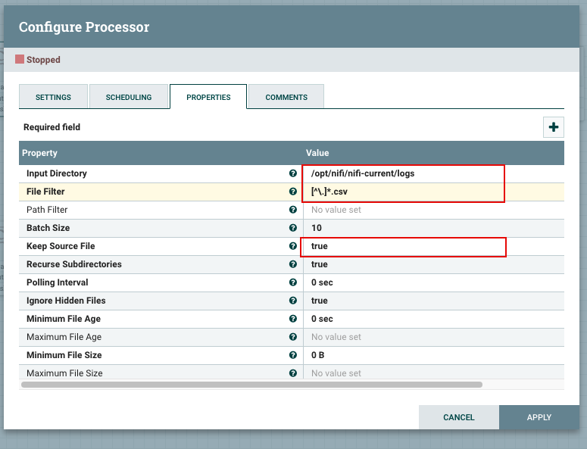
Data Pipeline setup part 1 – processor configurations
To have the pipe line works we need to configure the processors as follow:
Getfile processor config:
1. Set the input directory to the default nifi directory which Is mapped to our local directory as shown
2. Set the file filter to [^\.]*.csv to select all csv files in the
Located directory.
3. Keep source file : set this property to true to nifi will not delete the original data.
**of course you have to put your data.csv file into the mapped directory.

Slide 8
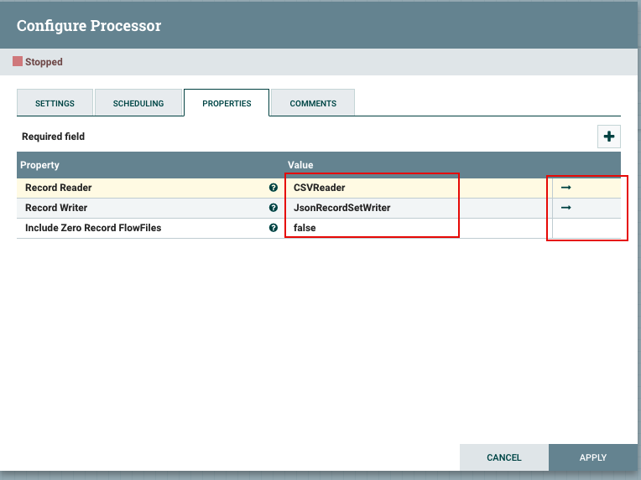
Data Pipeline setup part 2 – processor configurations
2. Convert record processor config:
1. Set the record reader to csvReader which can be selected by adding new service
2. Set the record writer to jsonRecordWriter which can be selected by adding new service from the drop down menu
3. Include Zero Record flow files must be set to false
** more importantly click on the highlighted arrows and activate the reader and writer as per the below snippet

Slide 9
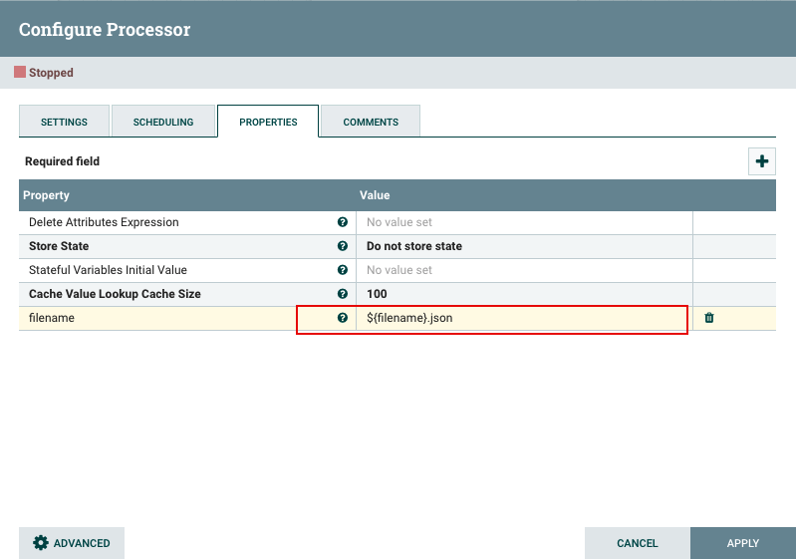
Data Pipeline setup part 3 – processor configurations
Updateattribute processor config:
1. Add a property and call is filename from the plus singe highlighted.
2. Set the name to ${filename}.json

Slide 10
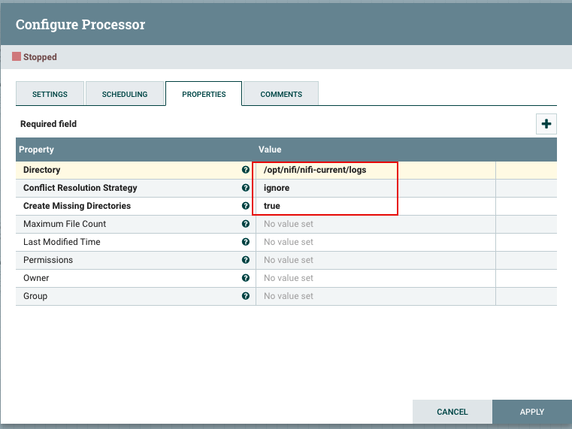
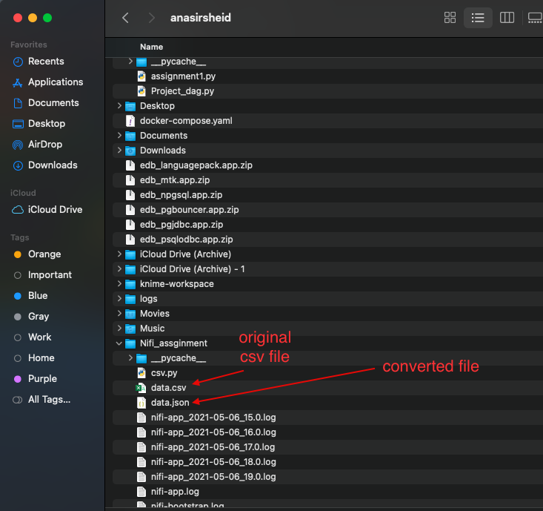
Data Pipeline setup part 4 – processor configurations
Putfile processor config:
1. Set the file path to be saved as the nifi default directory as it is at the end mapped to your local directoy
Set the Conflict Reolution Strategy to ignore so the process will stop once the file is saved.
Congratulations at the end the converted file will be saved at the mentioned destination

Slide 11
Thank You

